Slide 1
Introduction to Mathematical Statistics

Slide 2
Probability : Basic terminology
Random Experiment : A physical situation whose outcome cannot be predicted until it is observed. Can be repeated under identical conditions.
  Tossing a coin, Rolling a die.
Trial & Event : If a random experiment is performed, it results in any one of the several possible outcomes. The experiment is known as a trial & the outcomes are known as events.
  Tossing a coin is a trial and getting head or tail is an event.
Exhaustive events : The total number of possible outcomes in any trial are known as exhaustive events.
  In drawing two cards from a pack of cards the exhaustive no. of cases is ⁵²C_{2.}
Favorable events : The outcomes which make necessary the happening of an event in a trial are called favorable events.
  If two dice are thrown, the number of favorable events of getting a sum 5 is four, i.e. (1, 4), (2, 3), (3, 2) and (4, 1)

Slide 3
Probability : Basic terminology
Mutually exclusive events : Events are said to be mutually exclusive if two or more of them cannot happen simultaneously in the same trial.
  In throwing a die, all the 6 faces are mutually exclusive.
  Obtaining grades in exam.
Equally likely events : Events that have the same chances of occurring are said to be equally likely.
  Tossing an unbiased coin, rolling an unbiased die.
Independent events : The two events are said to be independent if the happening or not happening of one is not affected by the happening or not happening of other.
  If we draw a card from a pack of well-shuffled cards and replace it before drawing the second card, the result of the second draw is independent of the first draw. But, however, if the first card drawn is not replaced then the second draw is dependent on the first draw.
Complementary events : When there are only two possible events then non happening of one implies the happening of other. These two events are called complimentary events.
  Getting head or tail in tossing an unbiased coin.

Slide 4
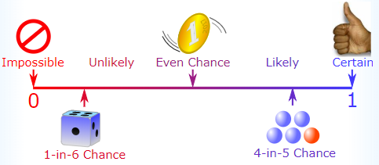
Probability : Definition (Mathematical Approach)
Definition : If a trial results in n exhaustive, mutually exclusive and equally
likely cases and m of them are favorable to the happening of an event E.
Then the probability 'p' of happening of event E is given by
p = P (E) = Favorable no. of cases / Exhaustive no. of cases = m / n
Example : p(getting head in a toss) = 1/2
Properties :
0 ≤ P ≤ 1 : Probability of an event lies between 0 & 1.
Probability of a certain event is 1 & Probability of an impossible event is always 0.
The sum of probabilities of all exhaustive cases is always equal to 1.

Slide 5
Basic terminology in terms of probability
Let A & B are two events which belongs to subspace S :
Events | Mathematical Expression
Exhaustive | A Ս B = S
Mutually Exclusive | P (A Ո B) = 0
Equally likely | P (A) = P (B)
Independent | P (A Ո B) = P (A) . P (B)
complimentary | P (A) = 1 – P (B)

Slide 6
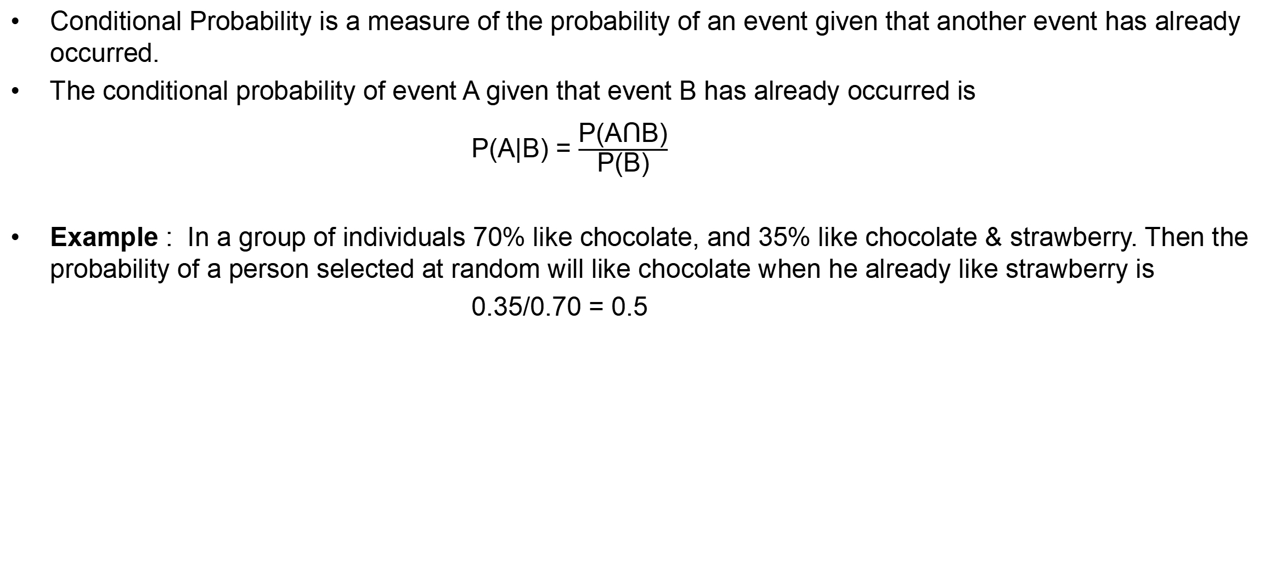
Conditional Probability
Conditional Probability is a measure of the probability of an event given that another event has already occurred.
The conditional probability of event A given that event B has already occurred is
P(A|B) = $\frac{\text{P}\text{(}\text{A}\text{Ո}\text{B}\text{)}}{\text{P}\text{(}\text{B}\text{)}}$
Example : In a group of individuals 70% like chocolate, and 35% like chocolate & strawberry. Then the probability of a person selected at random will like chocolate when he already like strawberry is
0.35/0.70 = 0.5

Slide 7
Probability : Limitations
The Previous approach of probability doesn’t work if :
The various outcomes of the trial are not equally likely.
    Probability that a candidate will pass in a certain test is not 50% since the two possible outcomes, success and failure are not equally likely.
    The probability of falling a ceiling fan is not 50% since the two possible outcomes, falling & not falling are not equally likely.
The exhaustive number of cases in a trial is infinite.
    Choosing a number form the set of all natural numbers.

Slide 8

Probability : Subjective Approach
Subjective Probability : Subjective probability is a type of probability derived from an individual's personal judgment about whether a specific outcome is likely to occur. It contains no formal calculations and only reflects the subject's opinions and past experience.
For example : If someone standing on a bus stop and he said that he has to wait for at least 10 minutes for the bus according to his past experience.
Applications & Exercise : Some numerical examples of probability are shown in the following file:

Slide 9
THANK YOU FOR YOUR
ATTENTATION

